Slide 1

Professor Profiler
Neha Anand
Notes:
Good afternoon everyone! I am Neha Anand. I am a data scientist with a background in chemical and petroleum engineering. Today, I will be talking to you about a tool that I have built which is aptly named Professor Profiler.

Slide 2
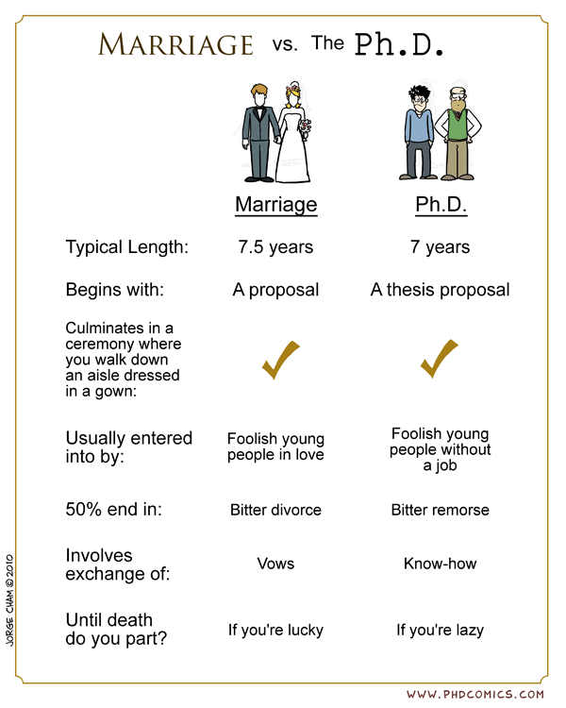


Problem Statement
Build a holistic profile of a university professor
Contact Information
University Information
Research area tags based on publications
Impact of research
Ratings/reviews given by past students
Target Users:
For prospective graduate students
For research collaboration
Notes:
This tools builds a holistic profile of a university professor based on his personal information, the university’s information where he works, his research profile and ratings given by the his students. The inspiration for this problem statement stems from my own tedious experience of applying to grad school and finding a thesis advisor. Grad school is a pretty long term commitment and this tool could reduce some (if not all!) the remorse students feel after school. Even though the tool is designed for students, it could be equally useful for research collaborators.

Slide 3

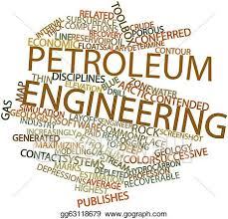




current scope
Petroleum Engineering
Top - 4 US schools
Research Professors
Publications after 2010
Two major journals
Total of 88 professors
~5700 publications
Notes:
The current scope of the project is limited to one major that is petroleum engineering and covers the research professors in the top-4 US petroleum schools. Their publications after 2010 were taken from two major journals. These filters gave me a total of 88 professors and close to 5700 publications to work with.

Slide 4

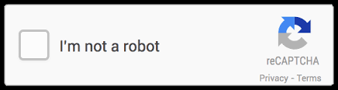
data acquisition
University Rankings
usnews.com
Faculty Information
University Websites
Faculty Rating
ratemyprofessor.com
Publication Information
Google Scholar/Scopus
Paper Abstracts + Titles
Journal Websites
Notes:
All of the data used for building this tool was web scraped. The university rankings were taken from usnews, faculty information from university websites, faculty ratings from ratemyprofessor and finally publication information from google scholar and journal websites. I would like to mention here: google scholar’s nasty habit of throwing captchas while I was scraping it which requires manual intervention every few hours (definitely made my life more difficult!).

Slide 5
unsupervised modeling process
DISCOVER RESEARCH TOPICS FROM PUBLICATIONS OF PROFESSORS
Data Cleaning and Exploratory Data Analysis
Clustering
Topic Modeling
Notes:
In order to discover the research areas being worked on by the professors, I undertook a three-step process: Data cleaning and processing, clustering and finally topic modeling.

Slide 6
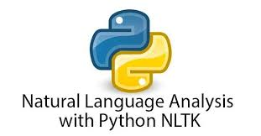
Data Cleaning and Exploratory Data Analysis
Clustering
Topic Modeling
Add domain-specific stopwords
Count Vectorization
Lemmatization
N-grams
POS tagging
Notes:
Starting with Stage 1: I set up a typical natural language processing pipeline using NLTK. The only different thing I did here was add domain-specific stopwords such as oil, gas, water etc. with the expectation that it would improve the model performance.

Slide 7

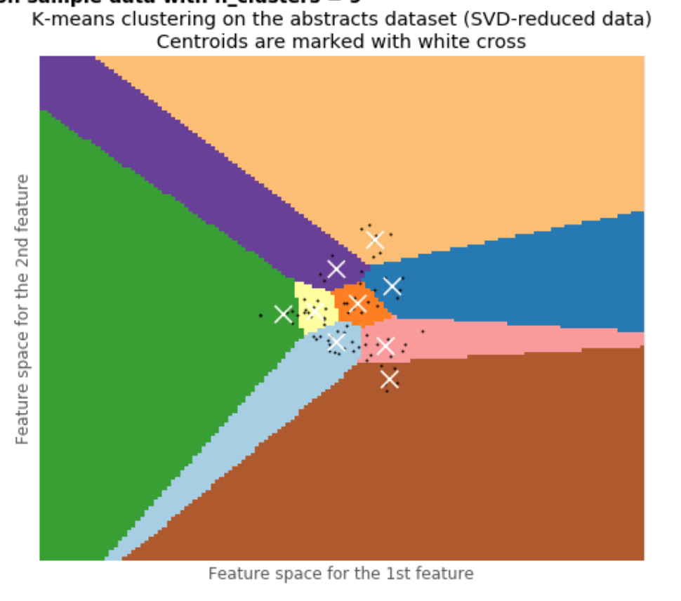
Data Cleaning and Exploratory Data Analysis
Clustering
Topic Modeling
K-Means clustering model
Visualize clusters using SVD
Optimize number of clusters using Elbow Method and Silhouette Analysis
Notes:
Coming to stage 2: My first intuition was to build a K-Means clustering model using scikit-klearn which would cluster professors by research areas. I went on to visualize the clusters using the SVD (as you see here) and optimize the number of clusters. The problem with this model was that one professor could only work in one area i.e. it was a hard clustering model Hence, I moved on to topic modeling.

Slide 8

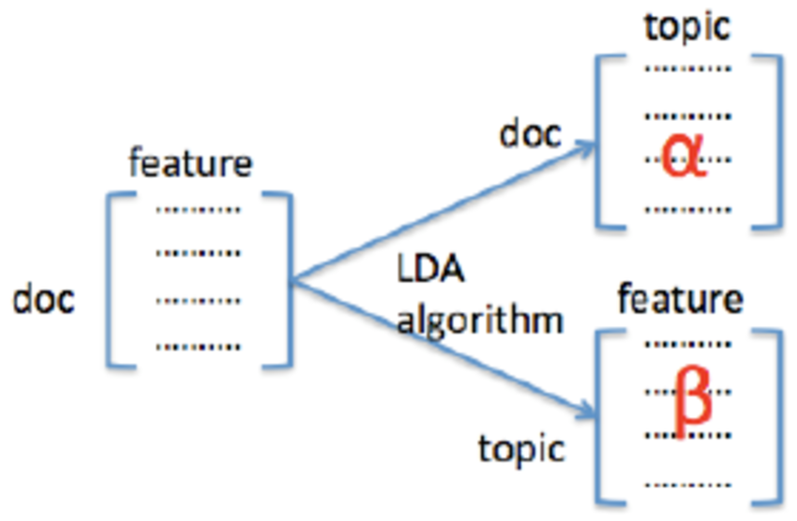
Data Cleaning and Exploratory Data Analysis
Clustering
Topic Modeling
NMF, LSI, HDP, LDA, LDA Mallet model
Visualize topics using pyLDAvis
Optimize number of topics using Coherence Plots
Notes:
Topic modeling allows professors to have multiple research areas. I built multiple probabilistic models using the gensim library, which utilize latent dirichlet allocation and non-negative matrix factorization algorithms. I visualized the topics generated and optimized them using using coherence plots. By coherence, I basically mean how human interpretable the words in each topic were.

Slide 9
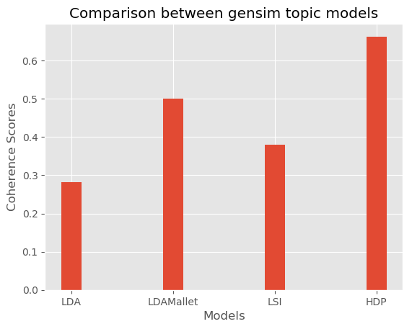
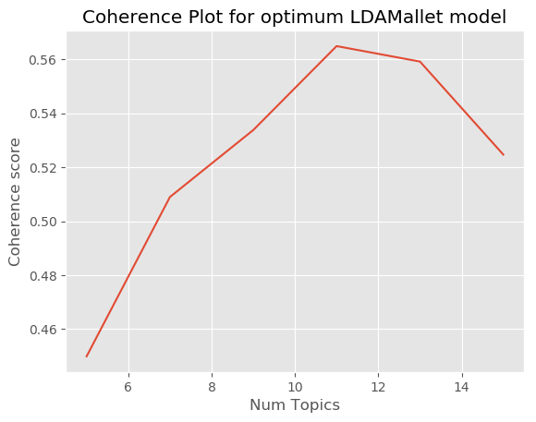
model comparison and evaluation
LDA Mallet
57%
11 topics
Visualization of Clusters/Topics
Coherence Score
Domain Knowledge
Run Time
Notes:
I compared the topic models on the basis of four metrics: visualization of clusters/topics, coherence score, domain knowledge i.e. petroleum engineering and run time of algorithms. LDA Mallet, which is a java based topic model scored the best. With 11 topics, it gave a coherence score of 57%.

Slide 10
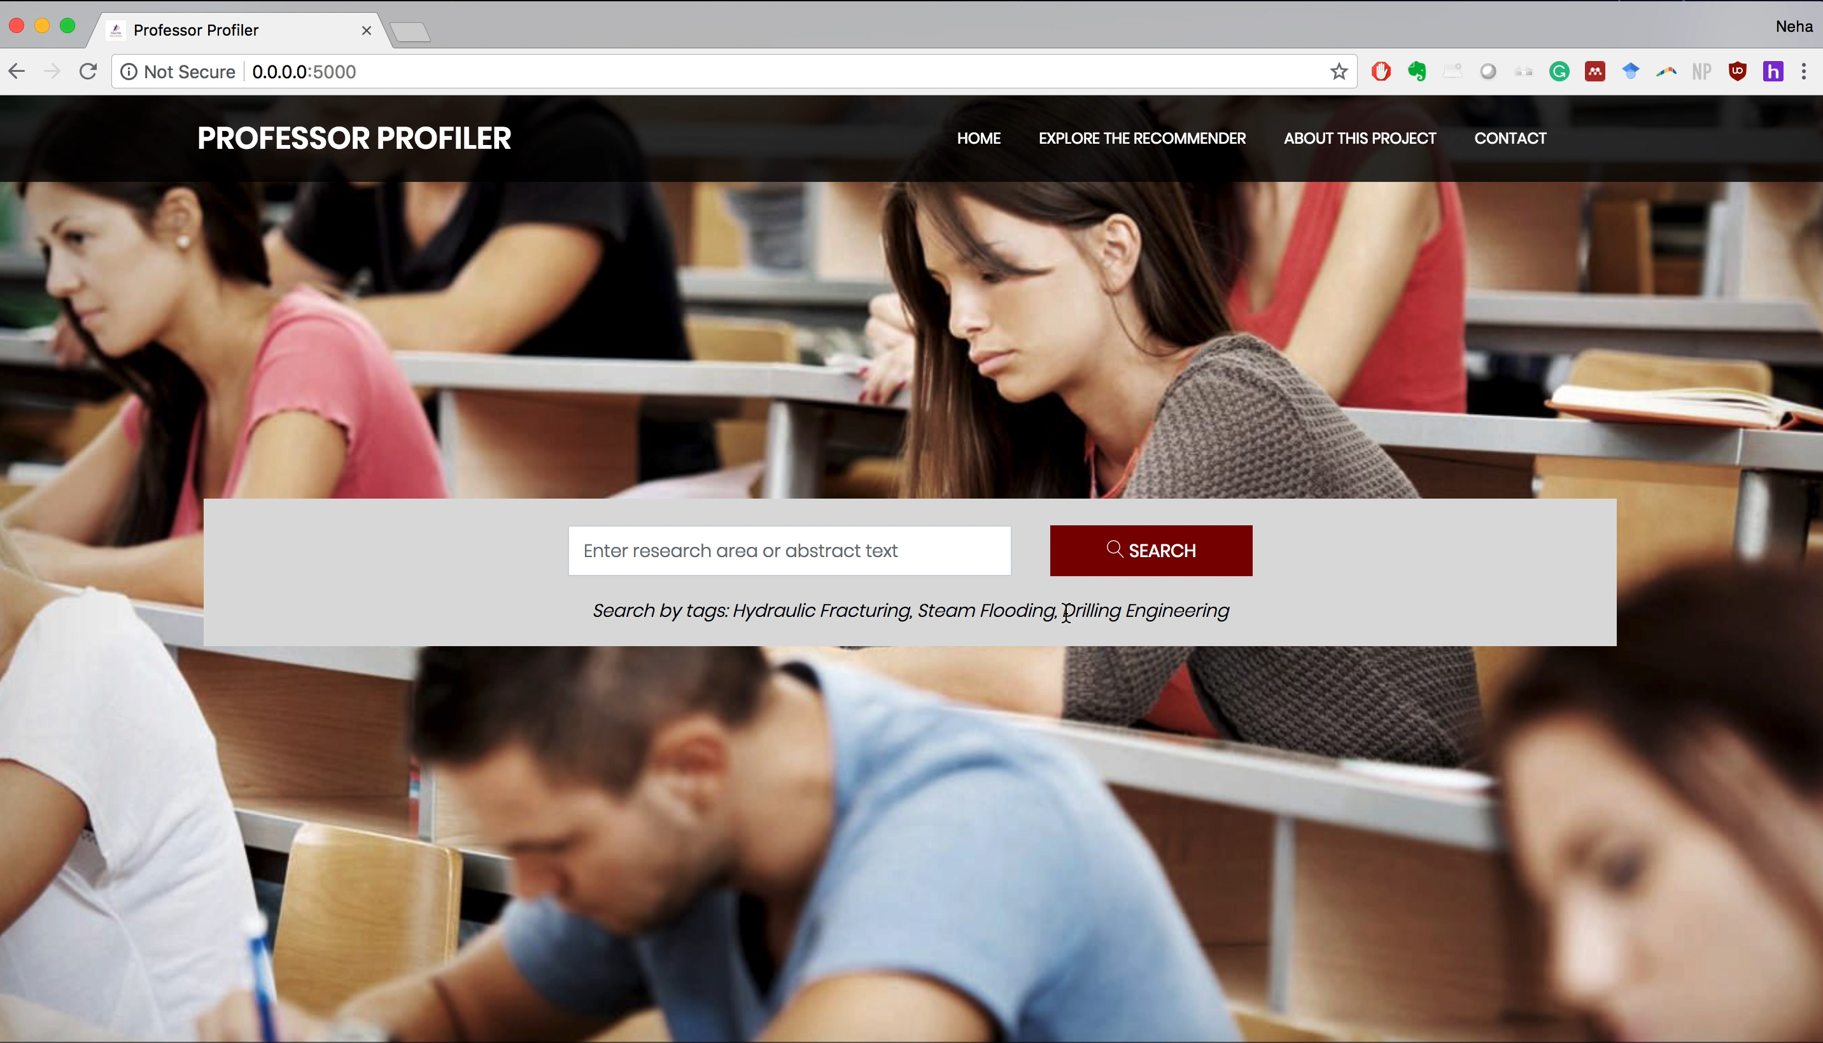
Notes:
Website demo: Here’s the website demo. I have tried to make the website as interactive as possible. The user enters a research area or text from his publication. The app shows professors working in this field. You can view all the details about a single professor as well including the subtopics he is specifically working on. The user can look at the details inside the recommender as well. It shows how the professors are grouped and which words are important to which field. The detailed topic plot summarizes all the results from my final topic model and in the final plot, you can look individually at each professor’s research topics.

Slide 11
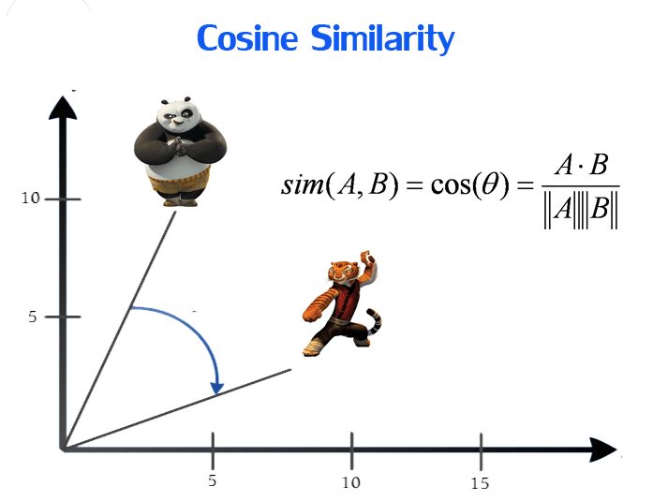
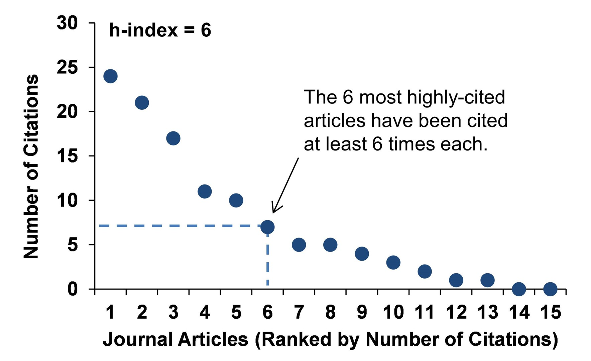
search results ranking cRITERIA
Notes:
The search results that a user gets is based not only on text similarity, but also gives importance to h-index (measures the impact of research), number of papers in database and the university rank.

Slide 12
Future work
Scale the project to include more:
Majors
Schools
Journals
Graph analysis of the research areas and professors
Time-series analysis
Notes:
In the near future, I would like to scale the project to include more majors, schools and journals and carry out a graph and time-series analysis of the research topics.

Slide 13
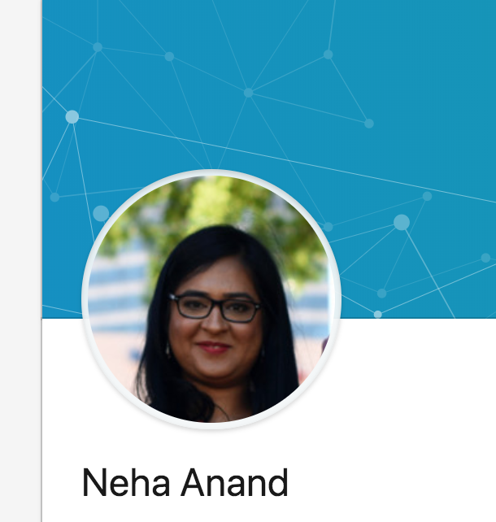


my profile
nehaanand8
neha8anand/professor-profiler
B.E. (Hons.) Chemical Engineering
M.S. Petroleum Engineering
Notes:
Once again, I am Neha Anand. Please feel free to connect with me. Thank you for listening.

